Slide 1













Content Opportunity Finder
NTU Module 3 · Congrui Liu
Turns YouTube comments into 3 video ideas a week for AI creators
TARGET USER
AI YouTube creator
AI Career · AI Tools · AI Agents
PAIN POINT
Too many comments
today: ~3 h a week reading by hand
GOAL
3 video ideas a week
backed by real viewer questions
My idea: a video is worth making when the comments show 3 signals
DEMAND
Many people ask it
+
GAP
Few videos on it
+
FRESHNESS
Rising this week
=
OPPORTUNITY
Worth filming now
→
score = 45% demand
+ 35% gap + 20% fresh
same question, many people
asked, but no video yet
last week ↑ vs the weeks before
How it works: 5 steps from raw comments to 3 videos
51,447 comments
→
25,226 clean
→
3,678 questions
→
50 topics
→
3 videos / week
YouTube API · 120 days
English, no spam
Supervised: question?
L03 · L04 · L09
Unsupervised: K-Means
L05 · L09
Score + back-test
L06 · L09
Result: Tested on 7 past weeks: 7 in 10 of our weekly ideas were still hot a month later (random: under 5 in 10)
Notes:
Opening. Target user = AI YouTube creator. Pain: too many comments, same question in many wordings. Opportunity = Demand + Gap + Freshness (each measured on slide 9).
If asked 'why ML?': 51,447 comments cannot be read by hand; meaning-based grouping needs embeddings.

Slide 2


02 Data
cleaning · time split
01 Overview
03 Filter
04 Topics
05 Score & check
06 Result
2
Data: real, recent comments; half was noise; split by time
DATA 51,447 raw › 25,226 clean
▸
FILTER 493 labels › 356 train · 137 test › 3,678 questions
▸
TOPICS 2,574 Jul–Sep · 1,104 Oct › 50 topics
▸
SCORE 3 videos
1 Collect
2 Clean: 51,447 → 25,226
3 Split by time (L06)
1
Official YouTube Data API
120 days · 28 Jun – 26 Oct 2026
Collected
51,447
Cut on 28 Sep
English videos only
langdetect*
40,805
Train
3 months · 16,523
Test
4 wk · 8,703
2
3 niches = my 3 content lines
AI Career · AI Tools · AI Agents
At least 5 words
27,131
3
5 real search words each
e.g. "how to get a job in AI"
28 Jun
28 Sep
26 Oct
English comments
langdetect*
25,658
Why not random?
51,447 comments
1,282 videos · 893 channels
names hashed (HMAC*)
Hindi-in-English removed
word list*
25,424
October comments would leak into training.
The tool only knows the past, so we test it that way.
Spam removed
same text 3+ times
25,226
≈ half was noise · * beyond the course
Key point
Real, recent comments; split by time so the model never sees the future (L06).
Notes:
Collect → clean → split.
Beyond the course: langdetect (guesses language from letter patterns), Hindi word list (patch for langdetect), HMAC hash (count people without storing names).
If asked 'why split by time?': random split leaks October into training; the real tool only knows the past (L06).

Slide 3

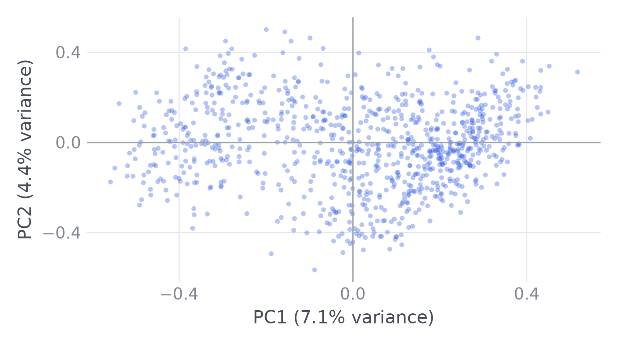
02 Data
cleaning · time split
01 Overview
03 Filter
04 Topics
05 Score & check
06 Result
3
EDA: 3 findings, each changed one step
What we saw → the evidence → what we changed
1 Wording
2 PCA
3 Viral
→ 04 Topics
→ 04 Topics
→ 05 Score
Finding
Same question, new words
No clear groups
One video fakes a trend
Evidence
"Is this really free?"
"Do I have to pay for it?"
e.g. AI Career · 6,170 comments
TF-IDF · 0 shared words
0 unrelated
MiniLM · meaning (L09)
0.54 similar
53% of the 16,523 training comments sit under just 10% of the videos
59% of 16,523 comments: closest in meaning, almost no shared words (MiniLM, L09).
Example: AI Career, 6,170 comments. One cloud; silhouette 0.02–0.09: no clear groups.
A popular video can look like a trend, so counting comments would mislead.
Change
→ Group by meaning (MiniLM)
→ No natural K: choose it in 04
→ Count people, max 3 per video
Key point
Group by meaning · K must be chosen, not found · count people, not comments.
Notes:
Model: all-MiniLM-L6-v2, the same pretrained sentence-transformer as Lesson 9 (22M params, 384 numbers); used as is, not retrained.
EDA, each finding changed one step. Findings 2 and 3 came from a first run of the pipeline, then changed the final build (iterative).
1 Wording: TF-IDF 0 vs MiniLM 0.54; 'Great video, thanks!' scores only 0.09. Cosine is a ranking signal, not a percentage (L09).
2 PCA: AI Career 912 questions, PC1 7.1% + PC2 4.7% of variance; one cloud → K must be chosen (slide 7).
3 Viral: 7 of 50 topics have >30% of questions from one video; e.g. 'Hardware to run AI locally': 10 of 19 people from one video → count people, max 3 per video.

Slide 4


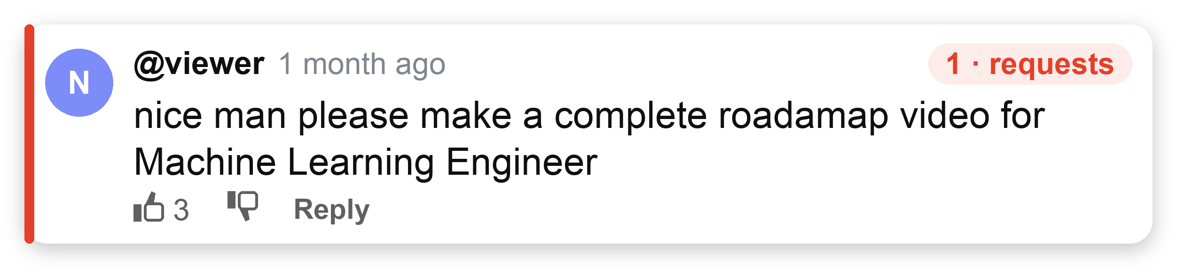
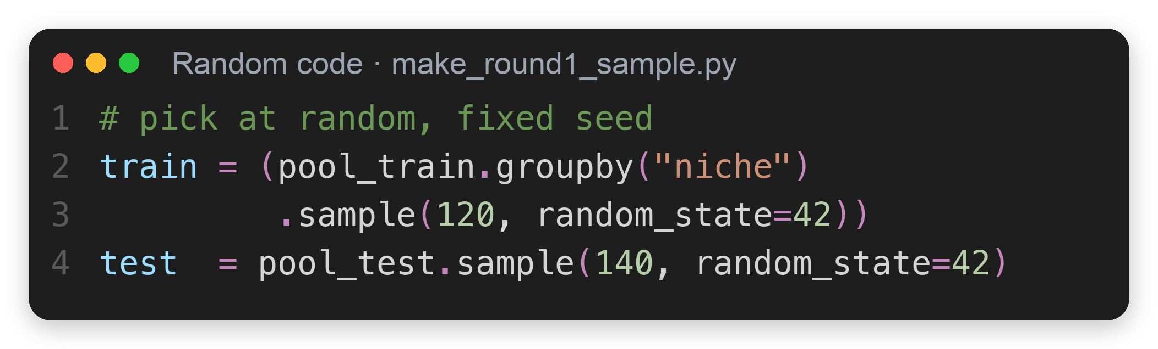
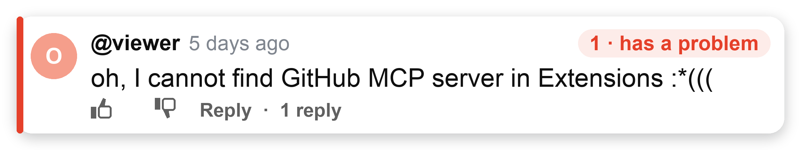
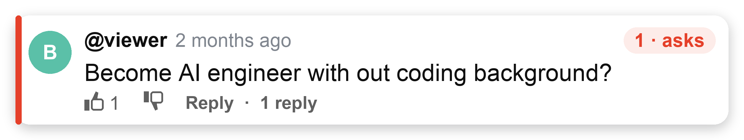
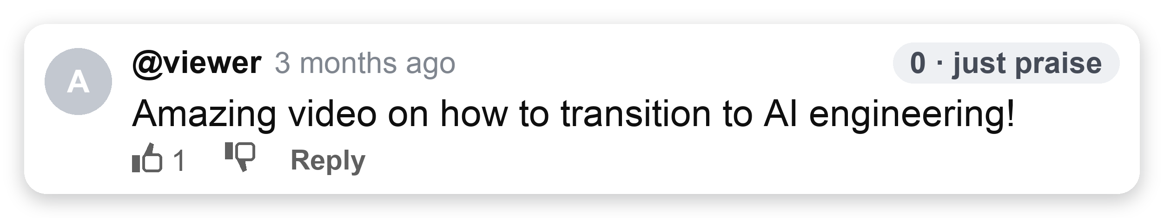
03 Filter
Supervised · NLP
01 Overview
02 Data
04 Topics
05 Score & check
06 Result
4
Find questions (supervised) ①: labels, the answer key
DATA 51,447 raw › 25,226 clean
▸
FILTER 493 labels › 356 train · 137 test › 3,678 questions
▸
TOPICS 2,574 Jul–Sep · 1,104 Oct › 50 topics
▸
SCORE 3 videos
1 What is a question?
2 How many labels?
3 Few labels: 2 checks
Question (1) = the viewer asks for something a video could give
493 comments to label 1 or 0
Check 1 · Unstable scores
↓ ① picked at random
If so: one model looks better just by luck
① CV
gap < SD of 5 fold scores → could be luck
slide 6
Check 2 · Works on new data?
↓ ② split by time (28 Sep)
If so: good on training comments, bad on new ones
Train
356
74 questions (21%)
① test
answered only by the unseen October test
slide 7
Jul–Sep · ~120 per niche
Test
137
19 questions (14%)
↓ ↓
② Both checks: confirm on the unseen October test
slide 7
Oct
Key point
493 labels teach and test the filter.
Notes:
Labels = answer key for supervised learning.
Sampling: 360 Jul–Sep (120 per niche) + 140 Oct, random, seed 42 (src/make_round1_sample.py); 7 removed by the Hindi filter → 493.
Same-topic pair (AI engineer): MiniLM similarity 0.63 but one is a need, one is praise; sets up slide 5.
Labels are AI-assisted with a written guide (do not call them my hand labels).

Slide 5


03 Filter
Supervised · NLP
01 Overview
02 Data
04 Topics
05 Score & check
06 Result
5
Find questions (supervised) ②: how we grade
DATA 51,447 raw › 25,226 clean
▸
FILTER 493 labels › 356 train · 137 test › 3,678 questions
▸
TOPICS 2,574 Jul–Sep · 1,104 Oct › 50 topics
▸
SCORE 3 videos
1 Score: F0.5 + a floor
2 Exam: 5-fold CV
3 Bar: baseline
What do we measure?
How do we test fairly? (356 training labels)
What must a model beat?
Only 21% are questions
1
grade
learn
learn
learn
learn
Rule: "?" = a question
21%
79% others
2
learn
grade
learn
learn
learn
actually yes
actually no
↓ causes
says yes
40
26
Class imbalance (L03): accuracy misleads
3
learn
learn
grade
learn
learn
↓ so use
4
learn
learn
learn
grade
learn
says no
34
256
Precision
kept ones are real?
Recall
found all real ones?
5
learn
learn
learn
learn
grade
each fold ≈ 71, 15 questions (21%, stratified)
Precision 40/66 = 0.61
Recall 40/74 = 0.54
↓ fakes inflate a topic, so precision first
↓
F0.5 precision counts ×2
average = CV score → pick the model
Baseline F0.5
0.59
every model must beat it
TO RANK
so the real test can wait:
TO PASS
precision ≥ 75% 3 in 4 real
October test closed until slide 7
Key point
Rank by F0.5, pass at 75% precision · pick by 5-fold CV · beat the "?" rule (0.59).
Notes:
5a. Only the 356 training labels; 137 test labels locked.
5-fold CV (L03): 5 rounds, each learns on ~285 and grades ~71 it never saw; the average is the CV score.
Baseline = common sense: a '?' means a need. Confusion matrix (L03) on the 356: correctly flagged 40, false alarm 26, missed 34, correctly ignored 256.
Precision 40/66 = 0.61, recall 40/74 = 0.54, F0.5 = 1.25×P×R/(0.25×P+R) = 0.59 (F-beta with beta 0.5, only if asked). A stronger hand-written keyword rule ('?' or request words) scores 0.65; only if asked.
Pipeline (L03): TF-IDF is fit inside each fold, so the graded fold never leaks into training.
Threshold: lowest cut-off with CV precision ≥ 75% → 0.50 for gradient boosting (slide 6).

Slide 6


03 Filter
Supervised · NLP
01 Overview
02 Data
04 Topics
05 Score & check
06 Result
6
Find questions (supervised) ③: features, then model
DATA 51,447 raw › 25,226 clean
▸
FILTER 493 labels › 356 train · 137 test › 3,678 questions
▸
TOPICS 2,574 Jul–Sep · 1,104 Oct › 50 topics
▸
SCORE 3 videos
1 Features: turn comments into numbers
2 Pick the model
all scores: CV on the 356 training labels
Baseline F0.5 0.59
Model
Precision
Recall
CV F0.5
CV gap vs 0.59
0.61
Word counts
TF-IDF (L09), keeps how / what / can
Baseline: "?" only
0.61
0.54
0.59
–
Logistic regression
0.75
0.41
0.64
+0.05
0.45
Meaning
all-MiniLM-L6-v2 (L09)
Random forest
0.79
0.30
0.59
±0
Gradient boosting ✓
0.75
0.49
0.68
+0.09
0.64
↓ tuned by grid search (L04): lr × depth · default 0.65 → 0.68 (+0.03, small)
Meaning + 3 rules ✓
384 + 3 joined = 387 numbers
→ only 3 of 5 beat the baseline
5-fold CV: 5 scores of GB
0.55
0.59
0.71
0.77
0.80
the 3 rules are: simple yes/no signs of a question
baseline 0.59
average 0.68 ± SD 0.10
"?"
question mark
how
how / what / can
please
please / help
↓
✓
Check 1 · better or just lucky? → impact: small gaps only
gap 0.09 < SD 0.10 → CV can’t tell → decide on the test (slide 7)
Key point
GB was best by CV (0.68 vs 0.59), but within ±0.10: the final test decides.
Notes:
5b. Rule evidence: '?' in 54% of needs vs 9% of others; question word 34% vs 5%; request 27% vs 3%; 34 of 74 needs have no '?'.
MiniLM alone is low: it groups by topic, not by how it is asked. Stop-words kept in the filter (how/what/can are the signal).
Precision ≈ 0.75 for all models by design (cut-off keeps precision ≥ 75%). GB +0.09 over the '?' rule, close to the CV spread ±0.10, so the test decides.

Slide 7

03 Filter
Supervised · NLP
01 Overview
02 Data
04 Topics
05 Score & check
06 Result
7
Find questions (supervised) ④: the final exam
DATA 51,447 raw › 25,226 clean
▸
FILTER 493 labels › 356 train · 137 test › 3,678 questions
▸
TOPICS 2,574 Jul–Sep · 1,104 Oct › 50 topics
▸
SCORE 3 videos
3 Final exam on test data
✓ 🤔Answers to slide 4: small data
TRAIN
Jul–Sep · 356 labels · learn + CV
TEST
Oct · 137
The 2 checks
Check 1 · Better, or just lucky?
Check 2 · Works on new data?
locked during training → opened once, here · 19 real questions inside
slide 4
slide 4
Gradient boosting
caught 13 of 19 · 5 false alarms
slide 6: gap 0.09 < SD 0.10
test: 0.71, no drop → yes
test: gap 0.26 ≫ SD → better
"?" rule
caught 10 of 19 · 13 false alarms
Why so few labels were enough
● caught ○ missed
① Pretrained MiniLM L09
② Strong rules
1B+ sentence pairs: meaning
has "?" in …
Gradient boosting F0.5 0.71
VS
"?" rule F0.5 0.45
questions
54%
356 ours
→ question?
transfer learning: only the last step is new
others
9%
→ Use gradient boosting: reads all 25,226 comments, keeps 3,678 questions
Key point
October exam: gradient boosting caught 13 of 19 vs 10; F0.5 0.71 vs 0.45.
Notes:
Grid search covered learning rate × depth only (4 combos); leaf size 20 is the default, checked separately.
Overfitting cause: 387 features, 356 rows. LR gap is smaller (0.13) but its CV 0.64 is below the rule.
Threshold 0.50 = lowest cut-off with CV precision ≥ 75%, a business choice (L03).
Test: 13 of 18 kept were needs = 72%; 95% range 49–88%; test F0.5 0.71 vs CV 0.68 is normal noise with 19 needs.
If asked 'CV shuffles but test is by time?': the filter classifies one comment at a time, it does not forecast; the real test is time-based.

Slide 8

04 Topics
Unsupervised · NLP
01 Overview
02 Data
03 Filter
05 Score & check
06 Result
8
Topics (unsupervised) ①: group by words or by meaning?
DATA 51,447 raw › 25,226 clean
▸
FILTER 493 labels › 356 train · 137 test › 3,678 questions
▸
TOPICS 2,574 Jul–Sep · 1,104 Oct › 50 topics
▸
SCORE 3 videos
1 Group 2,574 questions
2 Do groups make sense?
3 Are they stable? (ARI, L05)
By words baseline
Example: AI Tools questions
ARI = Adjusted Rand Index: run each method twice
higher = steadier · ✓ = steadiest → we use it
TF-IDF · same words → same group
By words share "did / video / just"
"Is there a paid course?"
"Where are the github links please"
"Was it a mountain biking accident?"
Career
Tools
Agents
By meaning L09
Words
0.30
MiniLM · same meaning → same group
0.23
0.43
✗ different subjects
Meaning
0.37
By meaning + PCA L05
0.47
384 → ~90 numbers, 80% of info kept, less noise
0.58 ✓
By meaning "Can I do the same with Claude?"
+ PCA
0.49 ✓
"The same possible with Claude Cowork and Code?"
"What tier Claude would I need?"
"Can I just throw this transcript to Claude?"
0.53 ✓
HDBSCAN*
0.49
HDBSCAN*
0.34
finds crowds itself, drops 15–32%
0.51
0.21
✓ one video can answer
* beyond the course
0 random
0.5
1 same
*ARI = (pairs the 2 runs agree on − chance) ÷ (max − chance)
Key point
Grouping by meaning was steadiest in all 3 content lines (✓), so that is what we use.
Notes:
Topics learned on 2,574 Jul–Sep needs; October's 1,104 used only to check (78–88% fit).
K: silhouette 0.02–0.09 for every K, like NorthStar (L05) → choose K for actionability: each topic ≤ 12% (even split of 10–25 topics = 4–10%; without the rule one AI Agents topic held 41%).
HDBSCAN (beyond course): density clustering, picks its own number of groups, left 15–32% out. Angles: combining 20 runs = voting (beyond course). 37 of 50 judged filmable by hand.

Slide 9

04 Topics
Unsupervised · NLP
01 Overview
02 Data
03 Filter
05 Score & check
06 Result
9
Topics (unsupervised) ②: the groups, and do they still fit?
DATA 51,447 raw › 25,226 clean
▸
FILTER 493 labels › 356 train · 137 test › 3,678 questions
▸
TOPICS 2,574 Jul–Sep · 1,104 Oct › 50 topics
▸
SCORE 3 videos
1 Group with K-Means (L05), one content line at a time
2 Do they still fit October?
LIKE TRAIN
learn on 2,574 Jul–Sep questions · meaning numbers (MiniLM, L09)
LIKE TEST
check on 1,104 Oct questions = 3,678 − 2,574
◯
topic centre · distance = cosine (L09)
K-Means →
closest meanings
→ one group
●
Jul–Sep: ring holds 90%
●
October inside = fits ✓
○
October outside = new theme
1 dot = 1 question
○ = centre of a group
October questions that fit:
AI Career
912 questions → 15 topics
AI Tools
684 questions → 20 topics
AI Agents
978 questions → 15 topics
AI Career
88%
AI Tools
78%
AI Agents
81%
= 50 topics
K chosen so each topic is small enough for one video (L05)
Jul–Sep: 90%
78–88% fit old topics: still usable · rest new → re-cluster monthly
Key point
50 topics, each small enough for one video; 78–88% of October still fits.
Notes:
Topics ②. K = topics per content line: AI Career 15, AI Tools 20, AI Agents 15 = 50. Silhouette was 0.02–0.09 for every K, so K was chosen for action: the biggest topic ≤ 12% (even split of 10–25 topics = 4–10%; without the rule one AI Agents topic held 41%).
October check: 90% of Jul–Sep questions fit a topic; in October 88% / 78% / 81%. Broad beginner topics grow, so refresh monthly. 37 of 50 topics judged filmable by hand. Angles (only if asked): each topic split into 1-video angles; combining 20 runs lifts ARI from 0.32–0.42 to 0.60–0.69 (beyond course).

Slide 10
05 Score & check
NLP · time-series test
01 Overview
02 Data
03 Filter
04 Topics
06 Result
10
Score: who asks, not yet answered, rising
Every Monday: each topic gets 3 signals → one score → Top 3 per content line
1 Score each topic
2 Gap: is there already a video? (L09)
Example: "Data science & ML career roadmaps" · AI Career
viewer comment
video title (90 days)
Demand
people ask
83
× 0.45 weight
+
Gap
no video yet
67
× 0.35 weight
+
Fresh
rising
58
× 0.20 weight
=
Score
72
↓ MiniLM
↓ MiniLM
meaning numbers
meaning numbers
↘ ↙
cosine: how close?
↙ ↘
rank 0–100 = how many of the other 12 Career topics it beats
weight = how much each counts: 45% + 35% + 20% = 100% (our choice)
≥ 0.60
a video already answers it
< 0.60
no video yet = gap
→ #1 of 13 AI Career topics: film it
0.60 = the cut that worked best (F1) on 150 checked comment–title pairs
This topic: 29 of 34 questions have no video → Gap 67
Key point
Asked by many, little video yet, rising → this week’s #1 in AI Career scores 72.
Notes:
Score = 0.45 D + 0.35 G + 0.20 F, each as rank 0–100; weights are a product choice (no label for 'a good video').
Gap uses semantic search (L09): question vs recent titles, cosine ≥ 0.60 = answered; checked on 150 AI-assisted pairs (ROC-AUC 0.82, precision 0.47: a hint, not proof).
Back-test (L06 rolling origin): hit = pick ends in the top half of next-4-week askers. Most asked 86% beats ours 70%, but 46% of its picks were already answered vs 13% of ours. 28 Sep was seen in an earlier version, so not fully unseen.

Slide 11
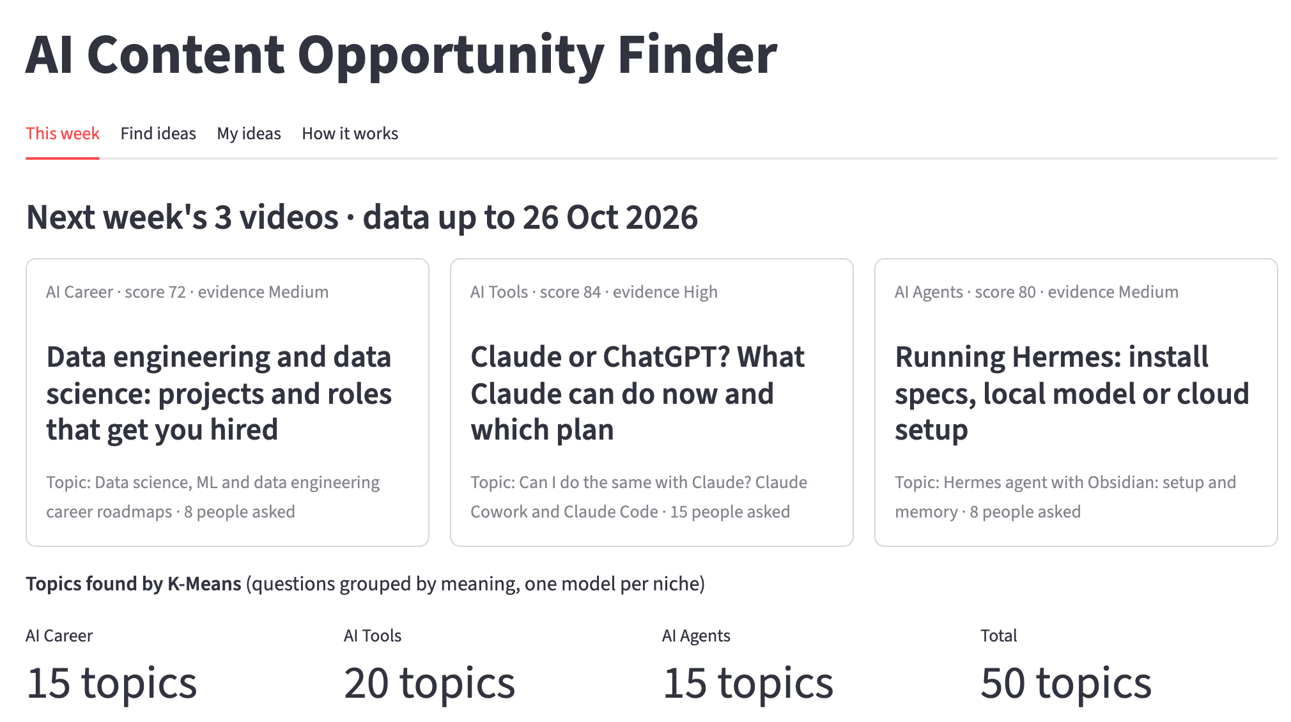


06 Result
deploy · next steps
01 Overview
02 Data
03 Filter
04 Topics
05 Score & check
11
Go live: the dashboard, its value, and what comes next
Streamlit dashboard: next week's 3 videos + 50 K-Means topics
Limit · opportunity · next step
LIMIT Too few labels
Label 500 more
OPPORTUNITY vs vidIQ / comment tools
they see searches or one video; mine finds what viewers across channels ask that no video answers, back-tested
SIZE (my time) Saves 2.5 h a week = 130 h a year
build ~50 h + 2 h a month upkeep → pays back in ~6 months
NEXT 8-week A/B test
A: most asked · B: ours · metric: 7-day views · roll out if B ≥ 1.1× A
weekly: API → filter → topics → score → dashboard · topic fit < 75% → re-cluster
Key point
Deploy now as a decision aid; roll out the ranking only if the A/B test wins.
Notes:
AI Tools pick: score 84 = 0.45×85 + 0.35×92 + 0.20×69.
If asked 'is Hermes a one-video trend?': in Jul–Sep 18 of 27 people came from one video, but this week it is 18 people from 9 videos and 7 channels (confidence High); demand also caps 3 people per video.
Limits: labels (kappa ≤ 0.31), small test (19 needs), ~70% gap is a trade-off and demand ≠ views (A/B test: ours vs most asked, 8 weeks, ≥1.1× views), drift (fit 90% → 78–88%; monitor weekly, < 75% → re-cluster).

